Slide 1
PYTHON WORKSHOP
WELCOME
TO
OUR
PRESENTATION

Slide 2
PASSWORD GENERATOR
TITLE :

Slide 3
Team No : 24
Team Name : PNP TECH

Slide 4
Team Members :
Nandhini.S
Pavithra.B
Pavithra.S

Slide 5
Academic Mentor :
Mr.Sathish(asst Prof)

Slide 6
Industry Mentor :
MISS.SUBASHINI.U
ASSOCIATE
KGISL GSS

Slide 7
ABSTRACT :
The project is about creating a password using python program.In today's world passwords are commonly used for the verification of thier identity.In this case people have to think too much for the unique and secure password.For this problem password generator is used.Its about creating a password containing characters,digits and special characters.This password generator will create a password in three cases light,middle or strong.Our main objective is to create a password generator which satisfies the user condition like adding specified data to the password like strings.The data will add in the start,middle or end of the password according to the user condition.This password generator will create a unique and secure password.

Slide 8
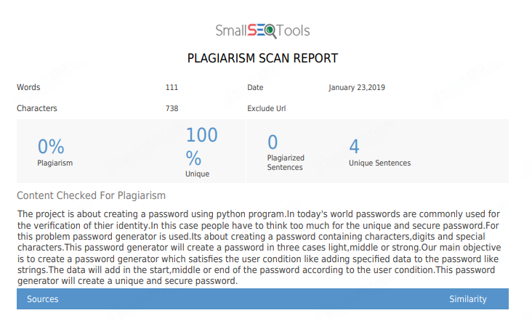

Slide 9
MODULES :
Password generator
Characters= alphabets, digits, special characters
Password= easy, middle, strong
User data=custom text
Get the data’s from the user
Generate a password

Slide 10
REQUIRMENTS :
Thonny editor
LANGUAGE :
Python

Slide 11
MODEL ARCHITECTURE :
Import random
Char=string.letters+string.numbers+string.punctuations
Password= light/middle/strong
User data=string
Random pic to generate password
Unique and secure password

Slide 12
SAMPLE CODE :
print('Hello, friend :)')
name=input('What is your name ? ')
print('{} ,nice to meet you '.format(name))
quess=input('How Secure must have 1-Easy/2-Stron/3-Very Strong : ')
choice=(int(input("if you want combine with custom text 1-Yes 2-No : ")))
if choice==1:
customtext=str(input("Enter Custom Text : "))
check=(int(input("if password \"End with your custom text Enter 1\" \" Start with your custom text Enter 2\" \"Mix with custom text Enter 3\" :")))
if check==1:
yourPassword=questPasswEnd(quess,customtext)
if check==2:
yourPassword=questPasswStart(quess,customtext)
if check==3:
yourPassword=questPasswMix(quess,customtext)
elif choice==2:
yourPassword=questPassw(quess)
else:
print("error choice")
question= input('Do you want show on the screen your password (yes/no)?')
if (question == 'yes'):
informationAboutPassword(yourPassword)
else:
print('See you late :)')
:

Slide 13
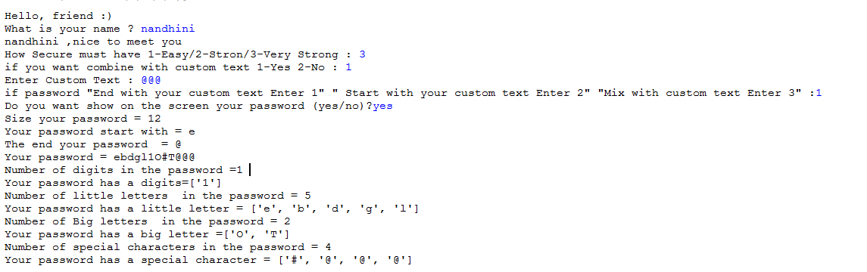
SAMPLE OUTPUT

Slide 14
It is developed to generate a unique and secure password
Thank you..

